Slide 1
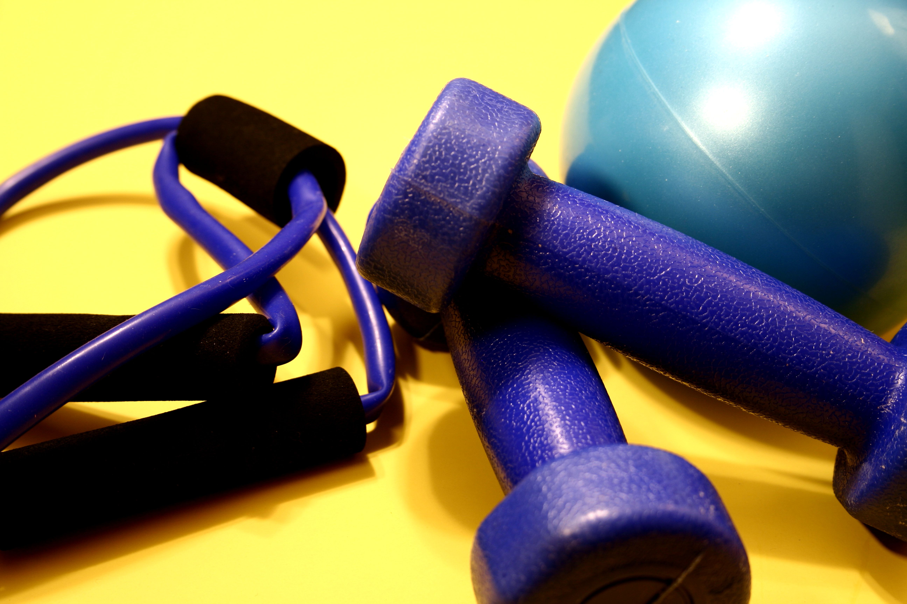
Pee Dee Fitness

Slide 2
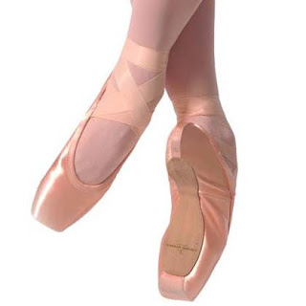
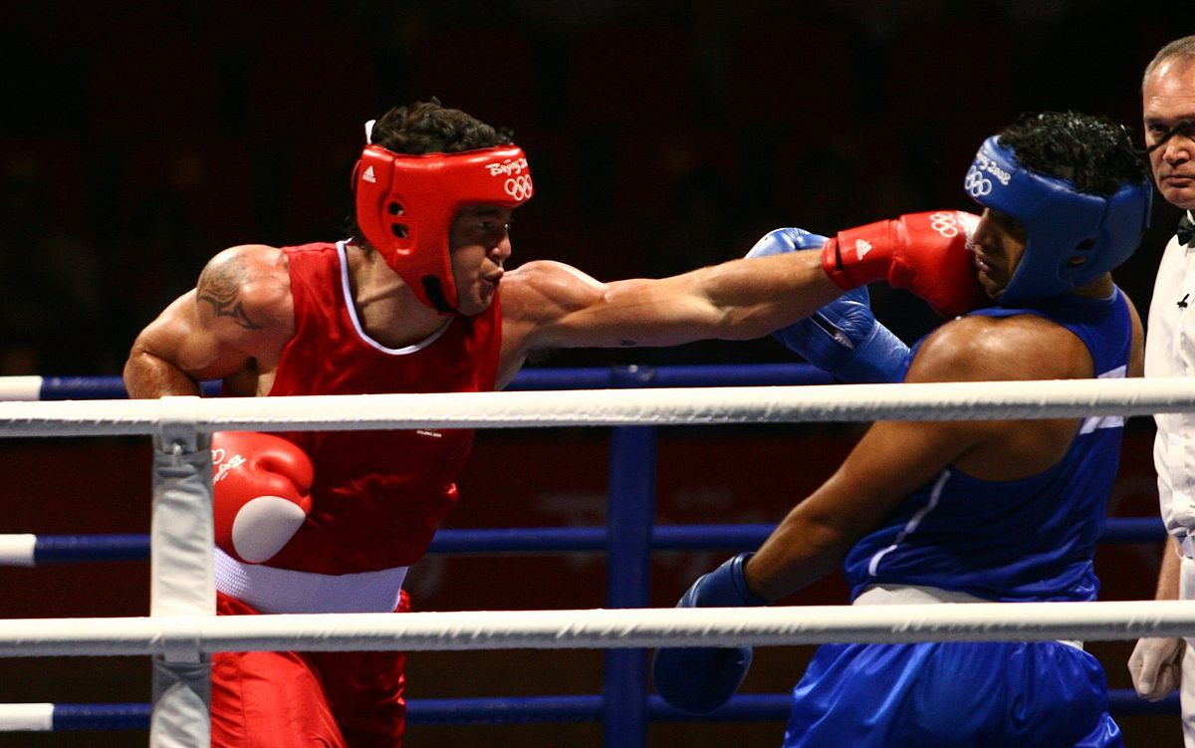
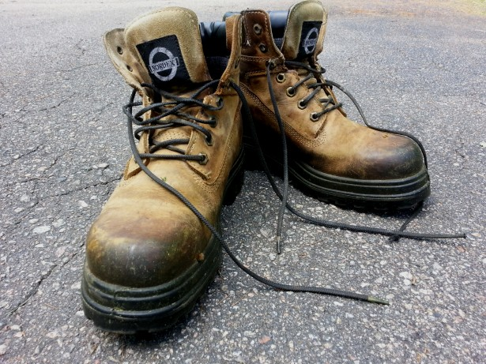
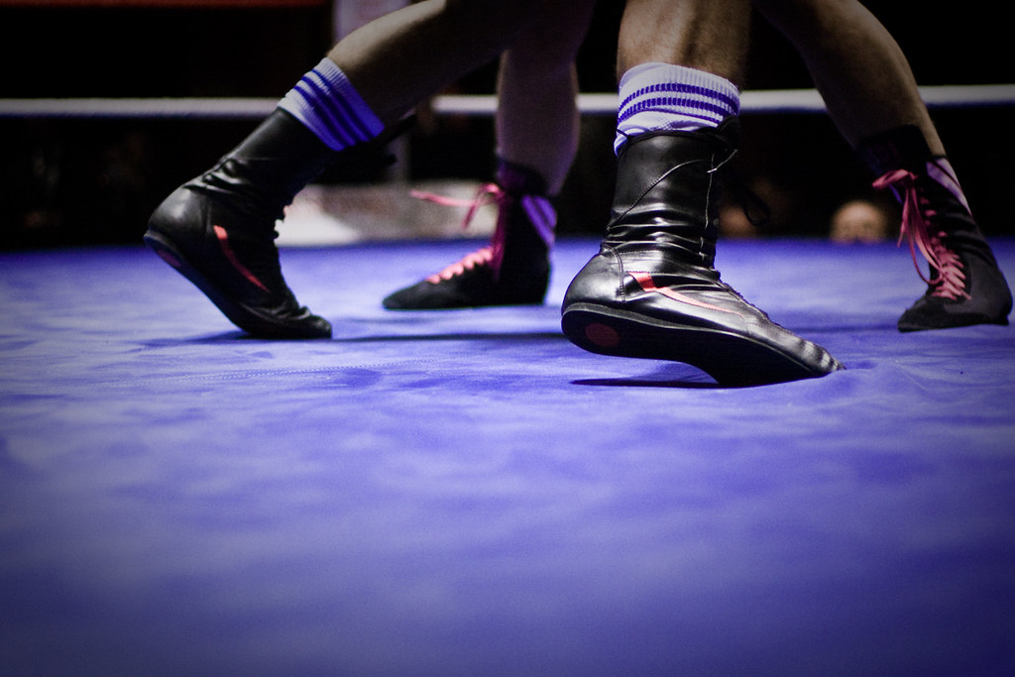
Whose Shoes
Did you have fun with, “Whose Shoes”? Who does the shoes belong to in the pictures? Look at the shoes, and let’s see if you can remember who wears the shoes.

Slide 3
Let’s get Fit!
What do you know about exercising?

Slide 4
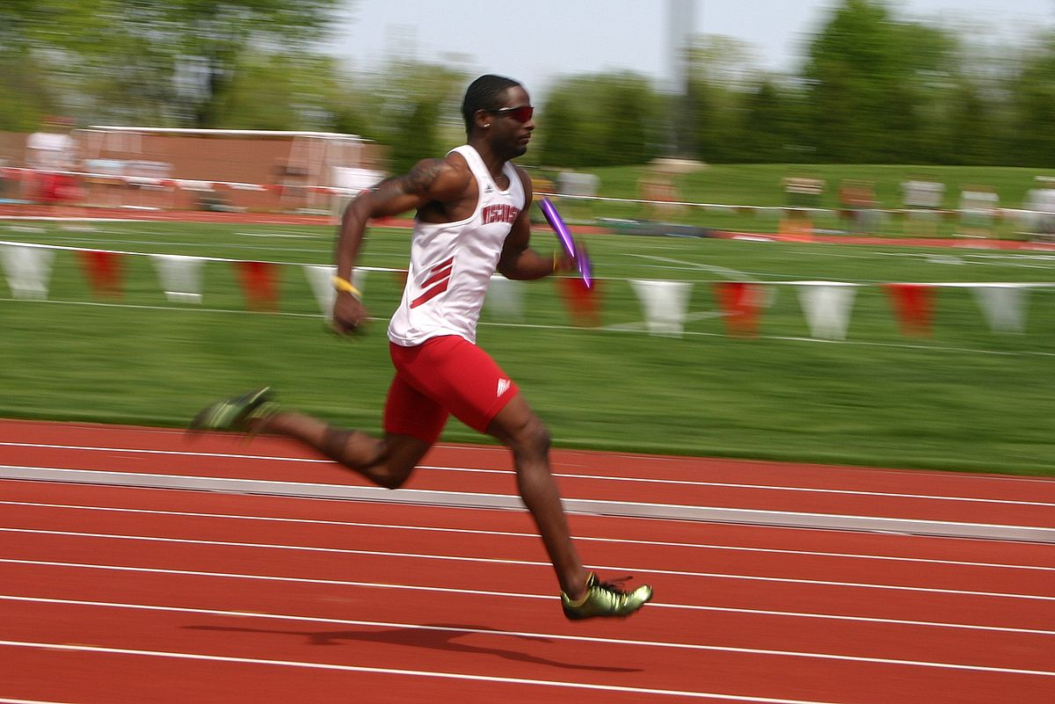
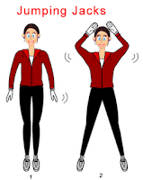
Walking
Types of Exercises
Running
Plank

Slide 5
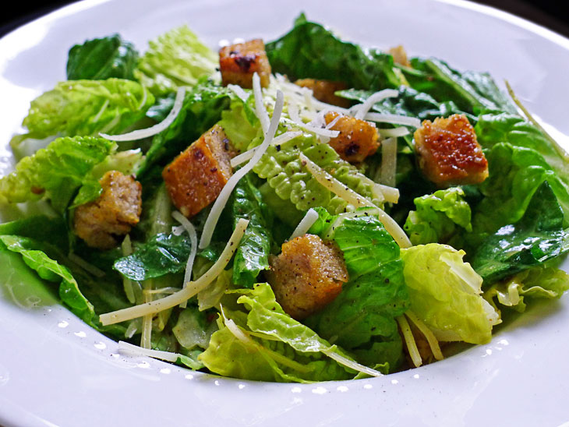
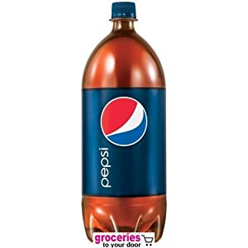
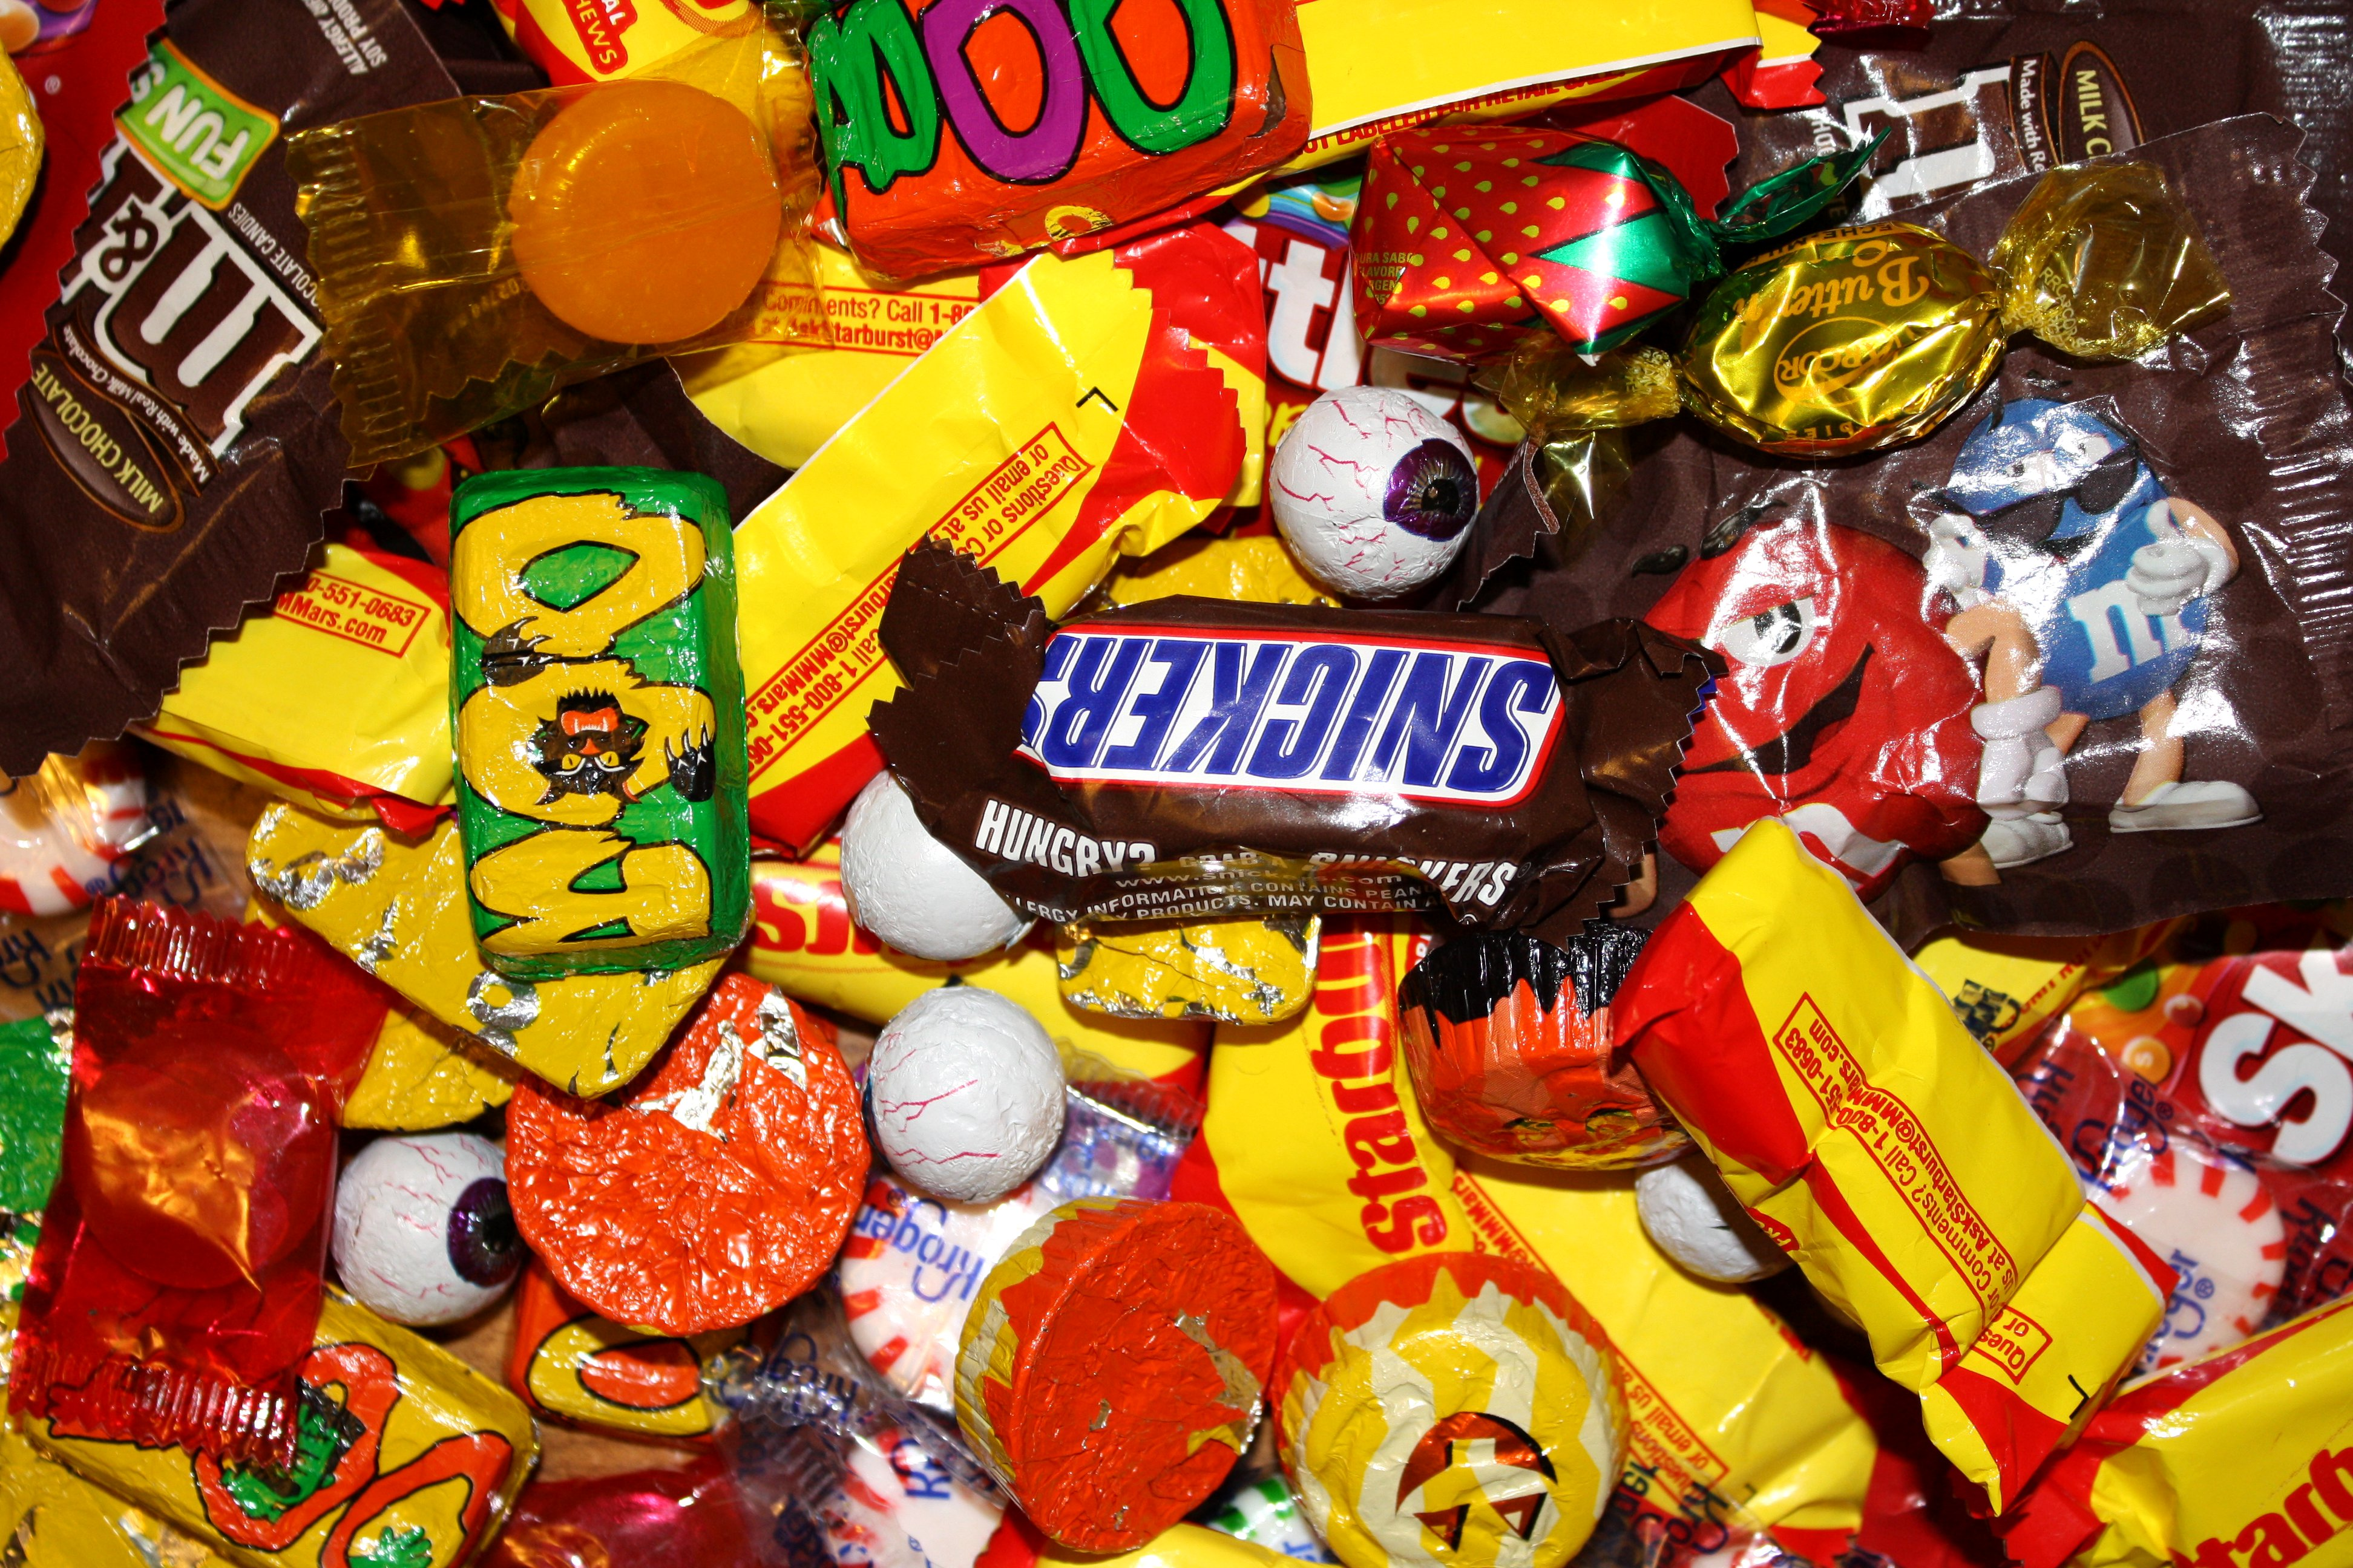
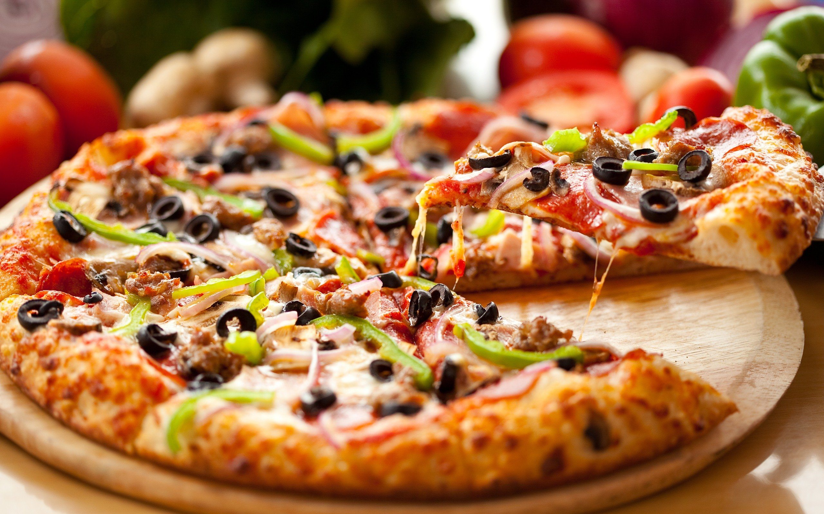
If we are trying to stay fit(healthy). What type of food should we eat?
Ask the child to respond, yes or no, as you point or say foods. After the child responds, yes or no, ask why is food healthy or unhealthy. Then ask them other healthy and unhealthy foods. Have the parents graph the responses.
Healthy | Unhealthy

Slide 6
Stretch
https://www.youtube.com/watch?v=kA-el4GTwVw

Slide 7
Advance Words
Remember we must stretch child/children’s vocabulary. We will use advance words to help them make connections. This will enhance their vocabulary.

Slide 8
Stretch
Be made or capable of being made longer or wider without tearing or breaking.

Slide 9
Snack
A small amount of food eaten between meals.

Slide 10
Breeze
A gentle wind.

Slide 11
Knot
A fastening made by tying a piece of string, rope , or something similar.

Slide 12
Exercise
Activity requiring physical effort, carried out to sustain or improve health of fitness.

Slide 13
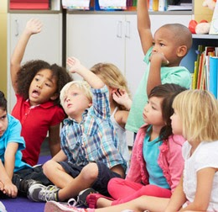
Book Reflection
Can you stretch to the ceiling or the floor?
How do you think an astronaut stretch?
Do you know to blow a bubble?
How big do you think a bubble can get before it pops?
What types of clothing do you need to exercise in?
What type of shoes do you need to exercise in?

Slide 14
Family Activities

Slide 15
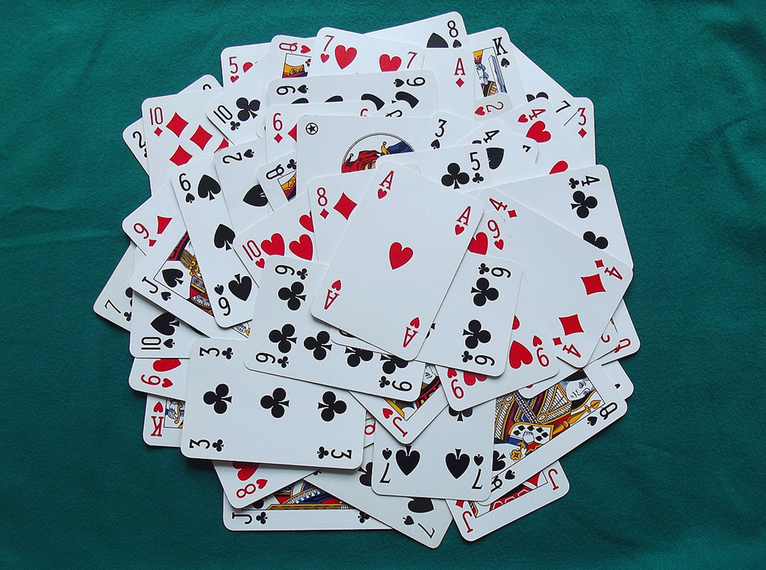
Pick a card any card
Ask your child does he/she know any types of exercises. Listen to what he/she says, if possible, write down the responses.
If you have a deck of old playing cards get them out. For example, if the child says, “Jumping Jacks” say “ok”. Now you need to pick a card. What ever they number is on the card, thats how many times you need to do this exercise.
Sample exercises:
Jumping Jacks, walking, running, lifting weights (you can put can goods in a bag for weights), jumping rope, planking, sit-ups, push-ups, mountain climbers, riding a bike, dancing, etc.
Come up with your own exercises.
Ask the child how fast do you think your heart is beating after a few exercises.
P.S. Talk about the card as well. Ask what color, shape, number, and/or letter that’s on the card.
Have Fun and get fit!
Math Activity

Slide 16
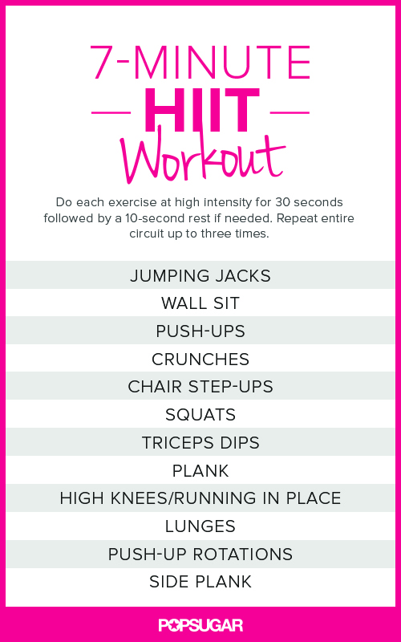
Family Gym
Let’s create a gym for you and the child/ren.
All you need is each other.
For 3 days a week, at least 20 minutes a day.
You can also recreate your own exercise to do with your family. Everyday you complete the work out allow the child to draw a happy face on the calendar. Let’s see many happy faces we can get.

Slide 17
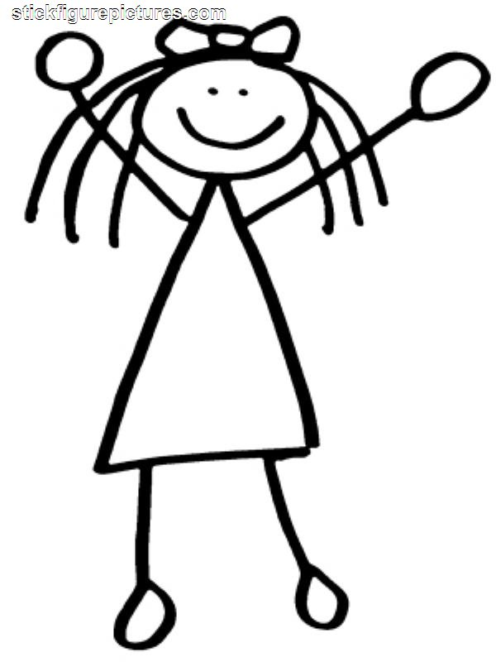
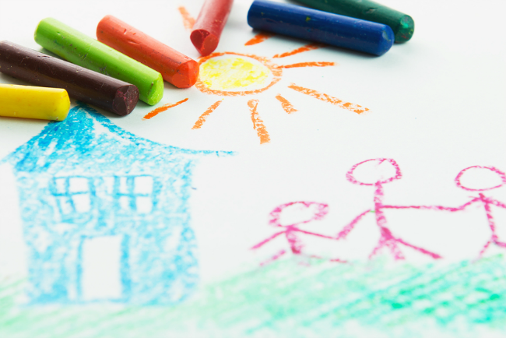
Membership Card
If we go to the gym, we have to have a membership card for each person in our family.
Get a sheet of paper.
Draw a box on the left side of the paper and allow the child to draw themselves in the box. On the other side of the paper they can draw their gym.
Make sure you write the name of the gym down for them. If they can write their name, allow them to write their name under the picture. If they can not write their name, have mom/dad help them write their name under the picture.
Faith

Slide 18
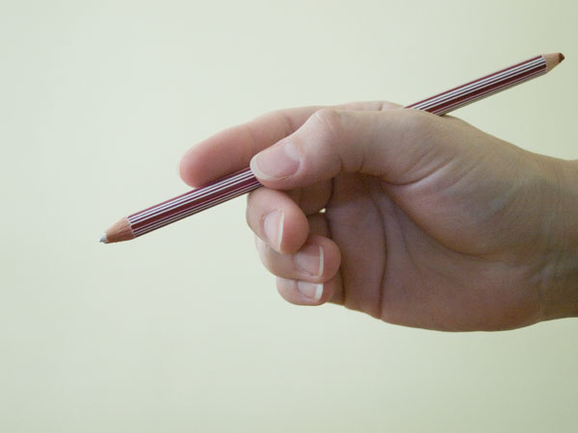
The Writing Corner
Get a sheet of paper without any lines.
Allow your child to draw straight lines.
The lines will not be perfect at first, but practice this everyday.
Do not draw dots for the child to trace.
The proper way to hold the pencil.

Slide 19
Great Minds that focus
Letter Recognition
https://www.youtube.com/watch?v=f2yZXhAHMk0
The letter Mm
Go on a letter hunt this week. Look for the letter: “Mm”
See how many times your child can find this letter.

Slide 20
Table Talk
Mom/Dad, how are ok?
Remember to make sure your child’s immunization record is updated on the Early Periodic Screening Diagnosis Treatment (EPSDT).

Slide 21
Additional Resources
www.education.com
Preschool resources
http://www.thelearningcommunity.us/kids-2-to-5/preschool-and-learning.aspx
Parent resouces

Slide 22
References
YouTube:
https://www.youtube.com/watch?v=L_A_HjHZxfI
Kids Workout- Family Fun
https://www.youtube.com/watch?v=635YI87hf7o
Kids hip hop work out
https://www.youtube.com/watch?v=67JzSRnyXr4
Letter recognition with Blippi
https://www.youtube.com/watch?v=f2yZXhAHMk0
The letter Mm
https://www.youtube.com/watch?v=kA-el4GTwVw
Stretch by Doreen Cronin

